Slide 1
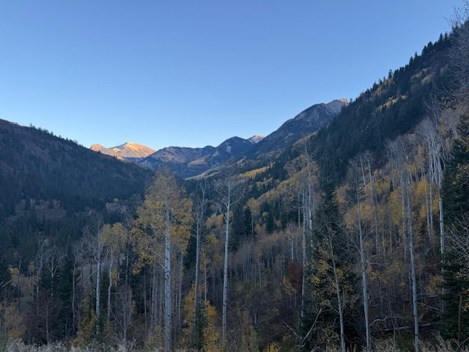
Charter Ridge 2025 Annual Meeting October 22, 2025

Slide 2
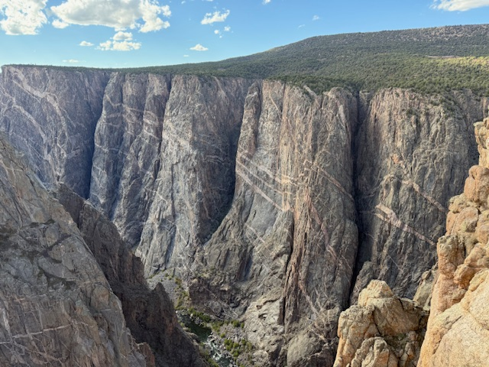
Agenda
Call to Order; Confirm Quorum
Approve Minutes of Annual and Special Members Meetings
Operations and Project Updates
Property Manager Report
Roofing and Painting Project Closing Report
Fire Mitigation Report
Other Operational Matters
Administrative Projects
Governing Documents Update
Survey Plat Review and Updates
Financial Review and Approval
FY ending September 30, 2025 Financial Position
FY ending September 30, 2026 Budget
Allocation of Dues
New Business
Exhibits and Back Up

Slide 3
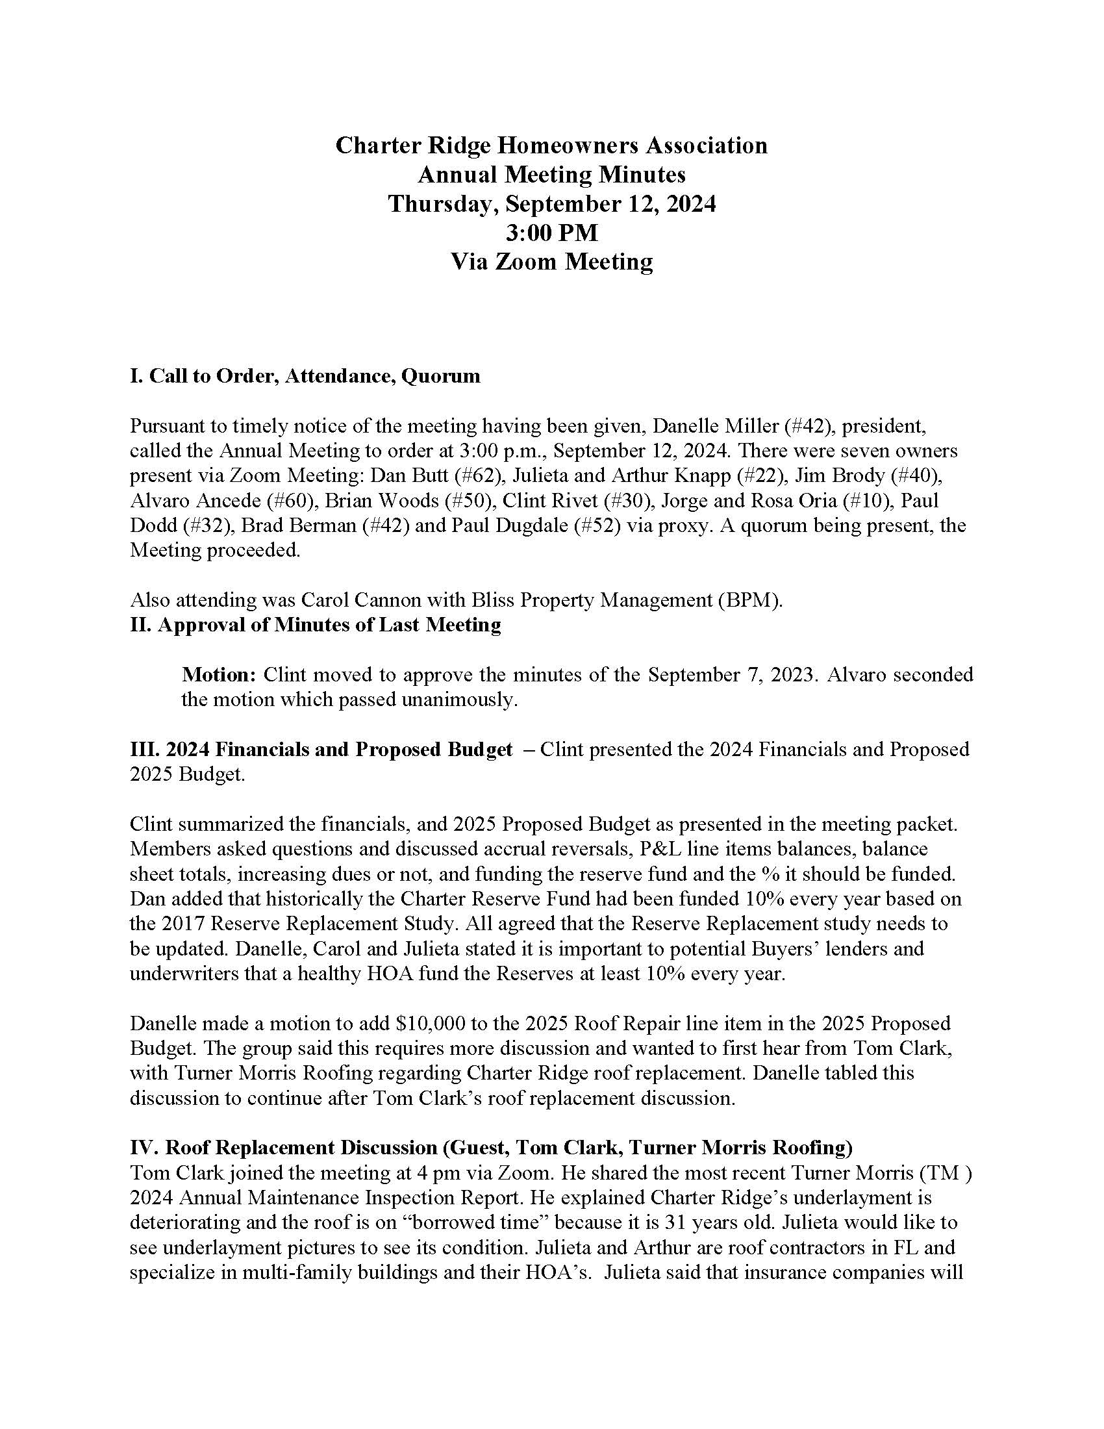
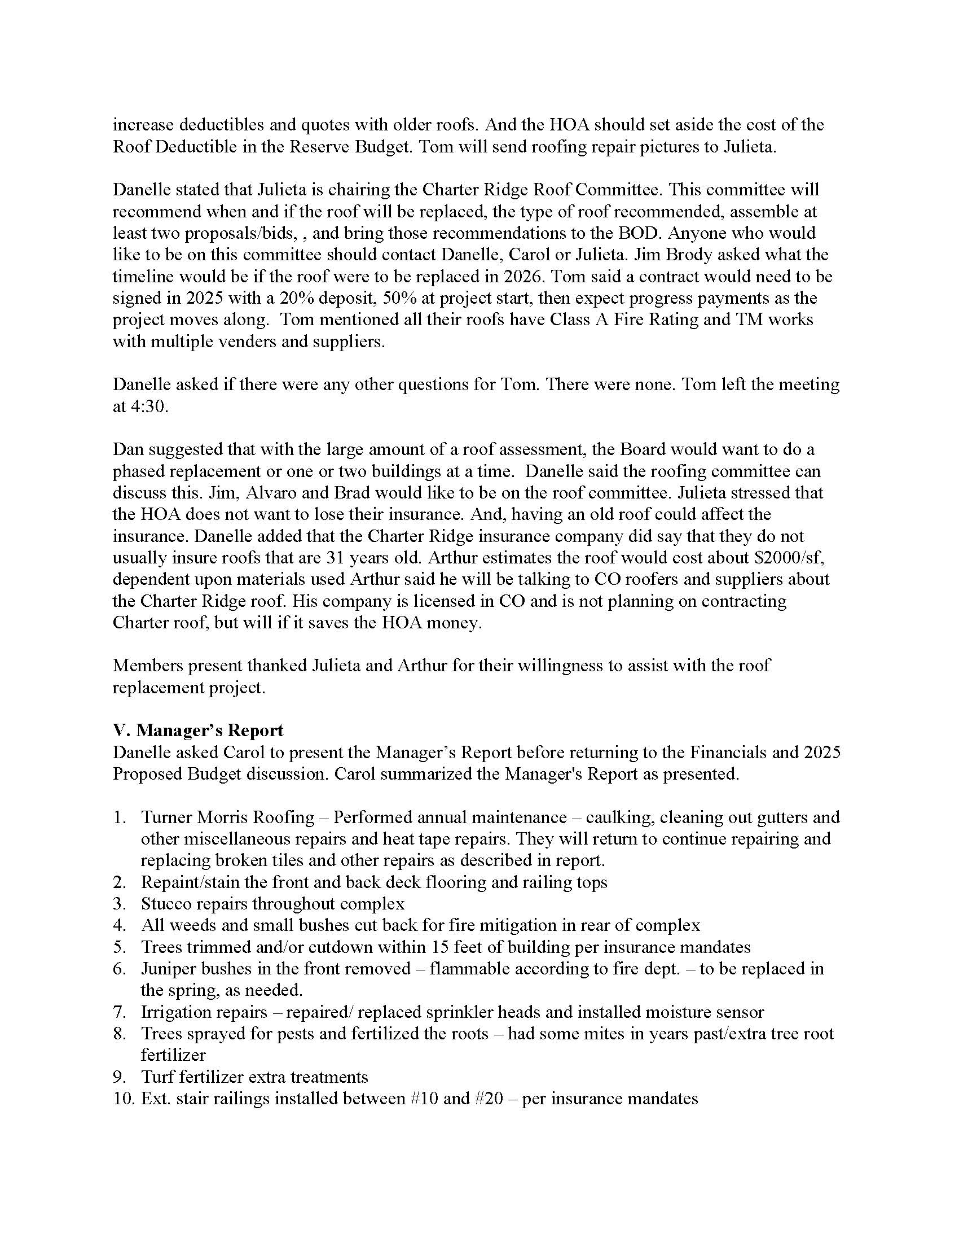

Slide 4
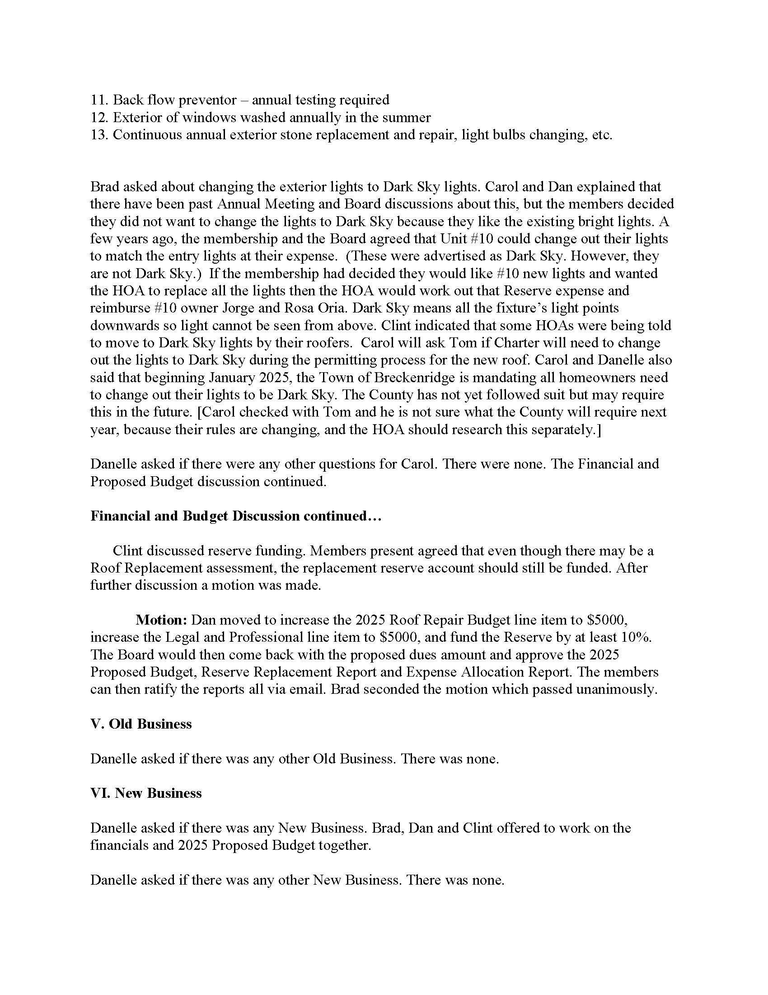
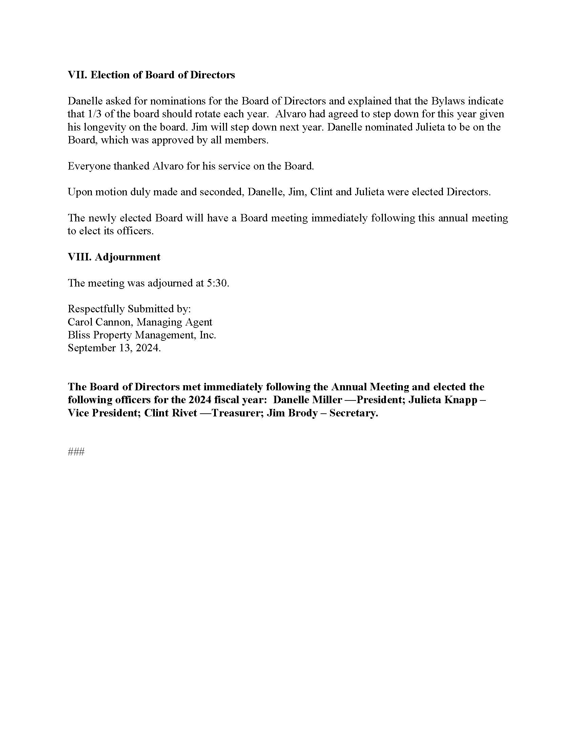

Slide 5
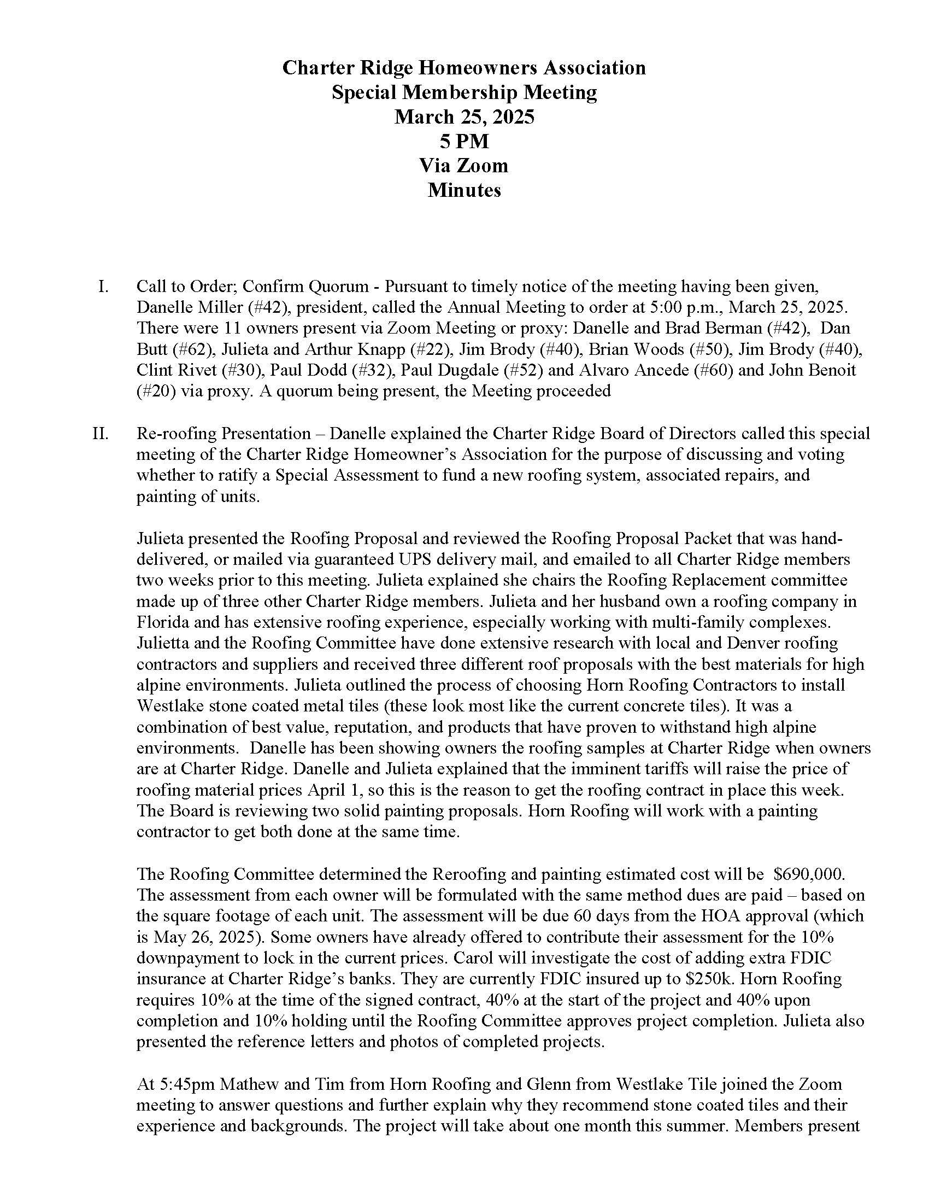
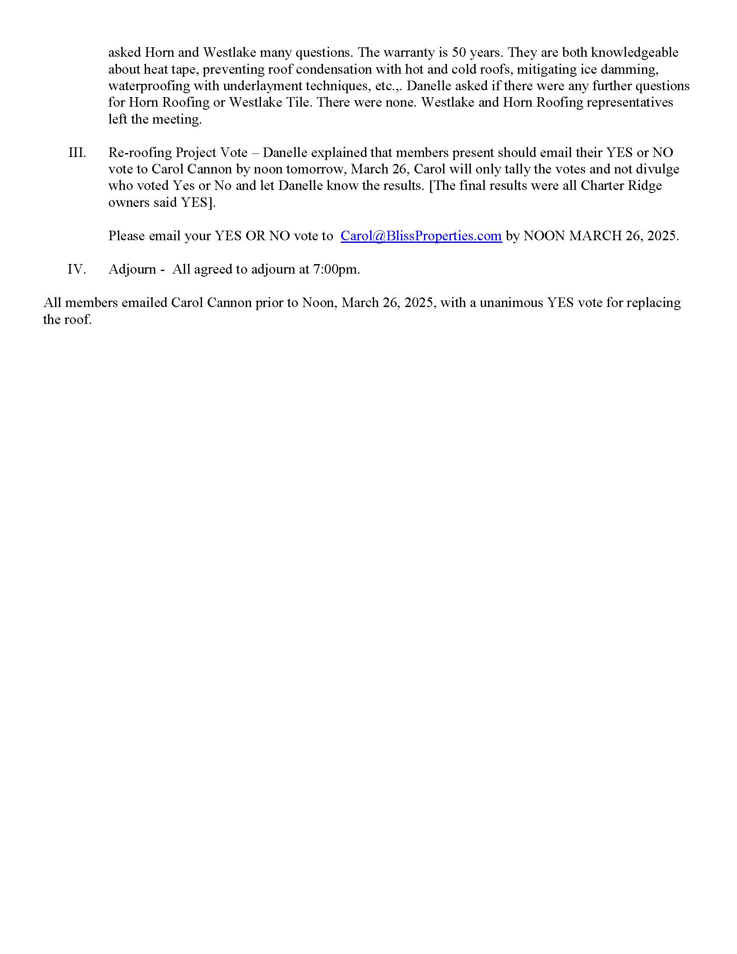

Slide 6
Operations and Project Updates

Slide 7

Property Manager Report
Carol Cannon

Slide 8
Property Management FY 24-25
Roofing & Exterior Projects
Turner Morris Roofing: Coordinated 2024 annual maintenance including caulking, gutter cleaning, and tile repairs.
Installed back stairs handrails (#10–#20) per insurance requirement.
Driveway #10 railing rebuilt/painted; entry balusters and chains repaired and stored for winter; faux stones replaced as needed. (annual tasks).
Enhanced Project Management: Provided oversight beyond standard BPM management contract, coordinating multiple contractors for roof, gutter, stucco, and painting projects, along with Board communications.
Hired, coordinated and managed final paint and stucco touch-ups.
Extensive post-construction clean-up.
Coordinated electrical contractor for new heat tape hookup.
Repaired sinking front step # 20 with new concrete step overlay

Slide 9
Property Management FY 24-25
Landscaping & Grounds
Seasonal landscaping: spring clean-up, summer mowing, turf fertilization, tree spraying.
Tree removal/trimming and juniper removal for fire mitigation and insurance compliance.
Irrigation repairs (root intrusion/kinking) and seasonal system maintenance.
Utilities & HOA Support
Installed new backflow preventer pressure valve; coordinated annual inspection.
Managed glass and window repairs, including broken window #50
Coordinated annual exterior window washing.
Oversaw multiple contractors for roof, gutter, stucco, and paint projects.
Coordinated HOA insurance communication and billing.
Coordinated and maintained HOA storage unit (lift station pumps, building materials).

Slide 10
Property Management FY 24-25
Reminders
Insurance company has mandated no charcoal or combustible grills on decks or balconies and no gas grills within 10 feet of overhang on decks . Consider using an electric grill if less than a 10 foot clearance from the lowest overhang.
Lock dumpsters during bear season.
Keep shovels, sand/ice melt, and winter supplies ready

Slide 11
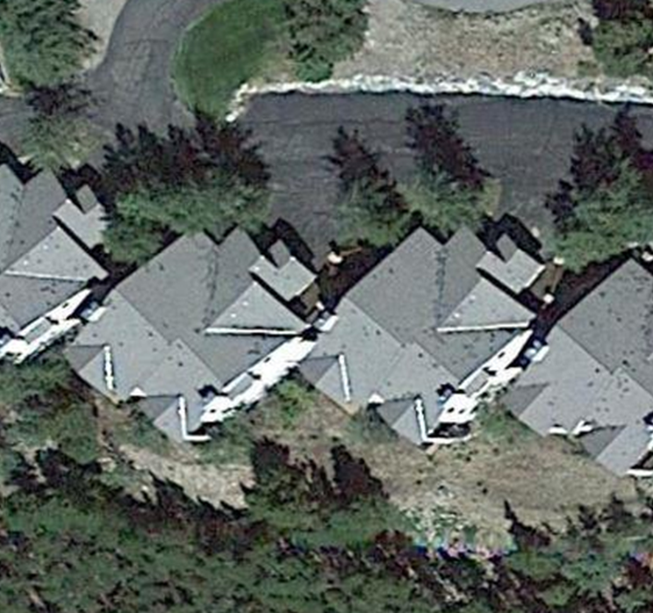
Roofing and Painting Project Closing Report
Julieta Knapp

Slide 12
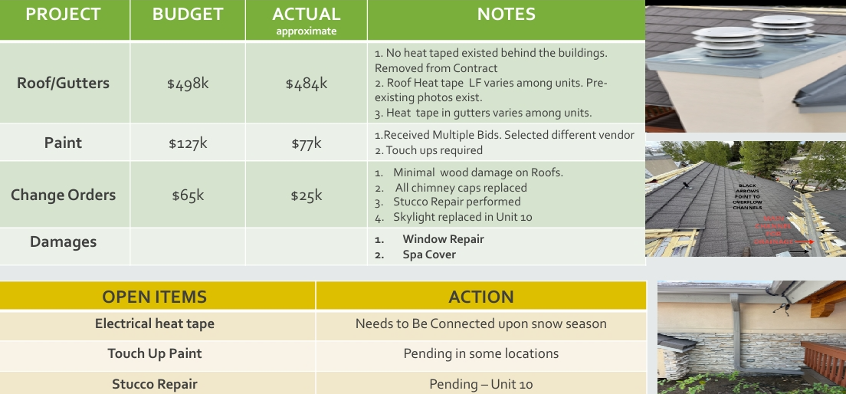
Project Recap

Slide 13
Completed Project Budget versus Actual
Budget:
Horn Roofing Base Proposal $497,924.79
Additional Costs and Contingencies $65,000
Painting $127,000
Total Special Assessment Approved by HOA Board to be Ratified by Members: $690,000.00
Actual:
Horn Roofing $496, 186
Additional Costs and Contingencies $12,044 YTD, some follow up expenditures anticipated in 2026. However, will not exceed original estimate
Painting $80,400
Total Fiscal Year 2025 Spend $588,630

Slide 14
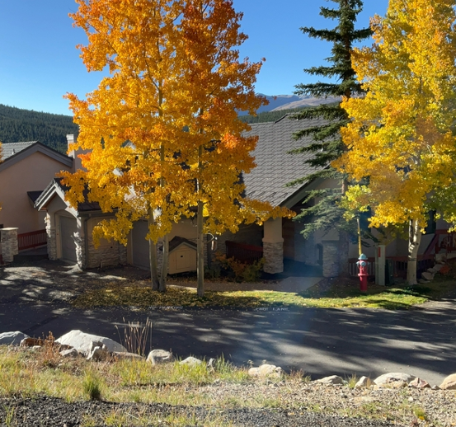
Fire Mitigation Report
Jim Brody

Slide 15
Fire Mitigation Report
Summit County conducted a wildfire mitigation assessment on October 2, 2025. Jim Brody accompanied the inspectors and gave full access to the property.
The inspector noted 10 Potential Defensible Space Improvements and one Potential home hardening improvement.
The inspector suggested that Charter Ridge consider engaging in the Firewise USA program (Miner’s View HOA currently participates).

Slide 16
Defensible Space Improvements Recommended
Remove combustible vegetation within 5 feet of structure
Remove or replace combustible mulch
Change address numbers -- do not meet standard
Remove combustibles under deck
Add spacing between shrubs
Remove juniper
Remove leaf litter and/or debris from deck
Remove dead shrubs
Remove combustible doormats (natural fiber doormats are vulnerable to embers)
Add spacing between trees in back (working with county open space and fire department)

Slide 17
Home Hardening Improvements Recommended
Check vents annually to make sure screens and flaps are still working
Note: More detail available in Exhibit: Summit County Wildfire Council Wildfire Mitigation Assessment

Slide 18
Administrative Projects

Slide 19

Governing Document Update

Slide 20
Governing Document Update
Altitude Law hired to conduct review of Articles of Incorporation, Declarations and Bylaws
Review report delivered March 13, 2025, finding non-compliance with current Colorado law and other issues.
Amendments put on hold to enable Board and Member focus on roof replacement and painting project without distraction.
Board reconnected with Altitude Law September 2025.
Altitude Law provided Amended Worksheet/Questionnaire on October 6, 2025 for the Board to complete before they proceed.
Estimated time: 12-14 months (depending on number of iterations and ease in amending; we believe we can shorten this)
Estimated Cost: $7,000 (depending on iterations and complexity)
Committee to Amend – any interested Members??

Slide 21
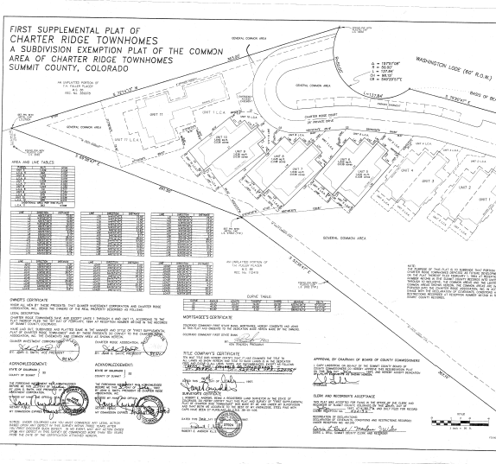
Survey Plat Review and Update
Danelle Miller & Carol Cannon

Slide 22
Survey Plat Review and Update
Why do this now?
Questions regarding limited vs. general common area within the Charter Ridge plat (member interest in parking expansion, other uses of LCA)
Identifying location of utility easement to protect access
Status
Original surveyor contacted; delays due to health issues
Surveyor visited site
Verbal response expected week of October 13
Report expected as soon as feasible

Slide 23
September 30, 2025 Financial Position

Slide 24
Charter Ridge Financial Position
The HOA ended September 30, 2025 fiscal year with $161,491 of cash compared to $60,473 as of September 30, 2024. This improvement is due to the lower cost of the 2025 projects due to the implementation of a competitive bidding process and lower contingency spend. See roof update for further details.
Cash available is allocated between an interest bearing and demand deposit accounts. The allocation is based on maximizing returns for owners while managing needs for operating expenses.
The September 30, 2025, deferred liabilities of $112,797 primarily reflect the excess of cash collected for the special assessment. The board plans to update the capital reserve target balance in 2026 after further analysis of the building components and identification of next steps.
Membership dues have generally been collected timely. We have one relatively small past due amount that we anticipate will be resolved shortly.
 | 9/30/2022 |  | 9/30/2023 |  | 9/30/2024 |  | 9/30/2025
Assets
Deposits | 10,960 |  | 34,416 |  | 11,915 |  | 41,116
Money Market | 74,779 |  | 46,798 |  | 48,559 |  | 120,376
Cash | 85,739 |  | 81,214 |  | 60,474 |  | 161,492
Accounts Recievable | 887 |  | 7,018 |  | 3,209 |  | 2,268
Prepaid Assets | 11,733 |  | 13,331 |  | 14,913 |  | 15,797
Total Assets | 98,359 |  | 101,563 |  | 78,596 |  | 179,557
Liabilities and Equity
Deferred Liabilities | 5,316 |  | 5,549 |  | - |  | 112,797
Accrued Liabilities | 3,305 |  | 4,410 |  | 8,315 |  | 2,761
Equity | 89,738 |  | 91,604 |  | 70,281 |  | 63,999
Total | 98,359 |  | 101,563 |  | 78,596 |  | 179,557

Slide 25
September 30, 2025 Trending Income Statement and FY 2026 Budget Summary

Slide 26
Charter Ridge Summary Income Statement
 | YTD 9/30/2023 |  | YTD 9/30/2024 | % | YTD 9/30/2025 | % | Budget 2026
Total Revenue | 132,153 |  | 132,244 | 0% | 719,126 | 444% | 141,245
Operating Expense | 101,279 |  | 131,643 | 30% | 122,593 | -7% | 144,588
Reserve Expenses | 32,760 |  | 20,850 | -36% | 602,815 | 2791% | 22,690
Total Expenses | 134,039 |  | 152,493 | 14% | 725,408 | 376% | 167,278
Income-Operating | 5,821 |  | (24,543) |  | (6,514) |  | (28,328)
Income-Reserve | (7,707) |  | 4,294 |  | 232 |  | 2,295
Income-total | (1,886) |  | (20,249) |  | (6,282) |  | (26,033)
Total revenue in 2025 was up by approximately $587,000 due to the roof and painting assessment. The membership recognizes revenue for special assessments when the funds have been expended for their intended purpose.
Operating expenses were down in 2025 compared to 2024 by close to $10,000. However, this was a result of higher tree spraying and landscaping of approximately $7,000, lower roof repairs offset by higher insurance expense of approximately $4,000, and higher management fees $2,400. 2026 budgeted revenue is consistent with 2025 and no increase in dues is budgeted. Additionally, no additional special assessments are anticipated at this time.
Reserve expenses were up due to the roof and painting project.
In 2026, operating expenses are up compared to 2025 actuals principally due to an increase in insurance cost of approximately $7,000 (15%), in snow removal cost of approximately $5,000 (or 48%) and increases in management fees of $2,400 (15%).
Net income is budgeted to be a $26,000 loss that will be funded by the significant increase in cash balances in 2025.

Slide 27
Revenue Component Trend Analysis
 | YTD 9/30/2023 |  | YTD 9/30/2024 |  | YTD 9/30/2025 |  | Budget 2026
Operating dues | $ 107,100 |  | $ 107,100 |  | $ 113,603 |  | $ 113,600
Reserve dues | 21,384 |  | 23,604 |  | 24,985 |  | 24,985
Interest Income | 2,030 |  | 1,540 |  | 1,816 |  | 2,000
Reimbursement | 1,639 |  | - |  | 660 |  | 660
Special Assessment |  |  |  |  | 578,062 |  | -
Total Revenue | $ 132,153 |  | $ 132,244 |  | $ 719,126 |  | $ 141,245
2025 revenue reflected the large special assessment significantly increasing year over year revenue. The membership recognizes revenue for special assessments when the funds have been expended for their intended purpose.
2026 operating and reserve dues are budgeted to be flat with 2026 due to the improvement in capital position of the membership.
Reimbursement revenue is based on a fraction of snowplow activity subject to easement reimbursement

Slide 28
Operating Expense Component Trend Analysis
 | 9/30/2023 | % change | 9/30/2024 | % change | 9/30/2025 | % change | 2026 Budget | % change
Accounting | $ 375 | 0% | $ 875 | 133% | $ 1,105 | 26% | $ 1,000 | -10%
Alarm Monitoring | 3,953 | 20% | 4,052 | 3% | 4,349 | 7% | 4,400 | 1%
Electric Entry/Bank | 139 | 8% | 148 | 7% | 113 | -24% | 165 | 46%
Insurance | 35,644 | 15% | 40,772 | 14% | 44,711 | 10% | 52,000 | 16%
Landscaping | 4,884 | -36% | 5,825 | 19% | 12,484 | 114% | 5,000 | -60%
Fire Mitigation | - | -100% | - |  | - |  | -
Roof Repairs | 3,574 | -65% | 22,098 | 518% | - | -100% | -
Maintenance Ext | 2,888 | -12% | 9,537 | 230% | 9,924 | 4% | 10,375 | 5%
Maintenance Int | - | -100% | 102 |  | - | -100% | 5,000
Management Fees | 12,000 | 11% | 13,200 | 10% | 15,600 | 18% | 18,000 | 15%
Misc | 360 |  | - | -100% | -
Legal and Professional | 2,541 |  | 175 | -93% | 1,956 | 1018% | 10,000 | 411%
Office Expense | 250 | 2% | 416 | 66% | 620 | 49% | 700 | 13%
Sewer | 10,589 | 4% | 10,971 | 4% | 11,352 | 3% | 11,448 | 1%
Snow Plowing | 6,270 | -5% | 5,940 | -5% | 6,600 | 11% | 7,800 | 18%
Snow Shoveling | 3,673 | 6% | 4,050 | 10% | 3,475 | -14% | 6,000 | 73%
Extra Snow Removal | 5,936 | 266% | 2,628 | -56% | 550 | -79% | 2,000 | 264%
Storage Unit | - |  | 287 | #DIV/0! | 1,094 | 281% | 1,300 | 19%
Tree maintenance | 3,275 | 26% | 5,200 |  | - | -100%
Trash removal | 1,755 | -48% | 2,381 | 36% | 4,457 | 87% | 4,600 | 3%
Sprinkler | 1,595 | -7% | 1,328 | -17% | 2,150 | 62% | 2,400 | 12%
Window cleaning | 1,578 | -11% | 1,658 | 5% | 2,002 | 21% | 2,300 | 15%
Tax Expense |  |  |  |  | 51 |  | 100 | 96%
Subtotal | $ 101,279 | -3% | $ 131,643 | 30% | $ 122,593 | -7% | $ 144,588 | 18%
In 2025, operating expense went down due to lower roof maintenance offset by higher insurance, landscaping, and management fees.
2026 expenses are up $20,000 on higher snow removal, insurance, and management fees partially offset by lower landscaping, including sprinkler repair.
Also, newer category of expense in 2026 includes interior maintenance to ensure grinder/elevator pumps are monitored and don’t result in sewer overflow issues in units.

Slide 29
Reserve Expense Trend Analysis
Reserve Expenses |  |  | YTD 9/30/2023 | % | YTD 9/30/2024 | % | YTD 9/30/2025 | % | Budget 2026
Install handrail |  |  |  |  |  |  | 4,800
Roof replacement |  |  |  |  |  |  | 497,662
Roof maintenance |  |  |  |  |  |  | 7,594
Painting |  |  |  |  | 12,350 |  | 80,400 |  | 1,000
Driveway |  |  | 32,760
Tree Removal |  |  |  |  | 8,500
Pump and window repair |  |  |  |  |  |  |  |  | 1,690
Component Repair |  |  |  |  |  |  | 12,359 |  | 20,000
Subtotal |  |  | 32,760 | n/a | 20,850 | -36% | 602,815 | 2791% | 22,690
2025 reflects large capital projects for replacing the roof, painting all units, and repairing the EIFS/ Stucco. Activities in 2025 allowed for a meaningful catch up of deferred maintenance activities outlined in the 2017 reserve analysis.
2026 reserve spend reflects significant reduction as the membership begins to evaluate the next phase of activities such as key equipment evaluations of grinder/elevator pumps in all units as well as the remaining components outlined in the reserve assessment.

Slide 30
Allocation of Dues

Slide 31
Allocation Summary
No assessment increases in 2026
Note that small rounding differences on a monthly basis (e.g., $6 whole dollars between reserve and operating accounts will be allocated in line with the budget)

Slide 32
New Business

Slide 33
Exhibits and Back-Up

Slide 34
Exhibits
Exhibit A- Proposed Summit County/Town of Breckenridge Trail Development

Slide 35
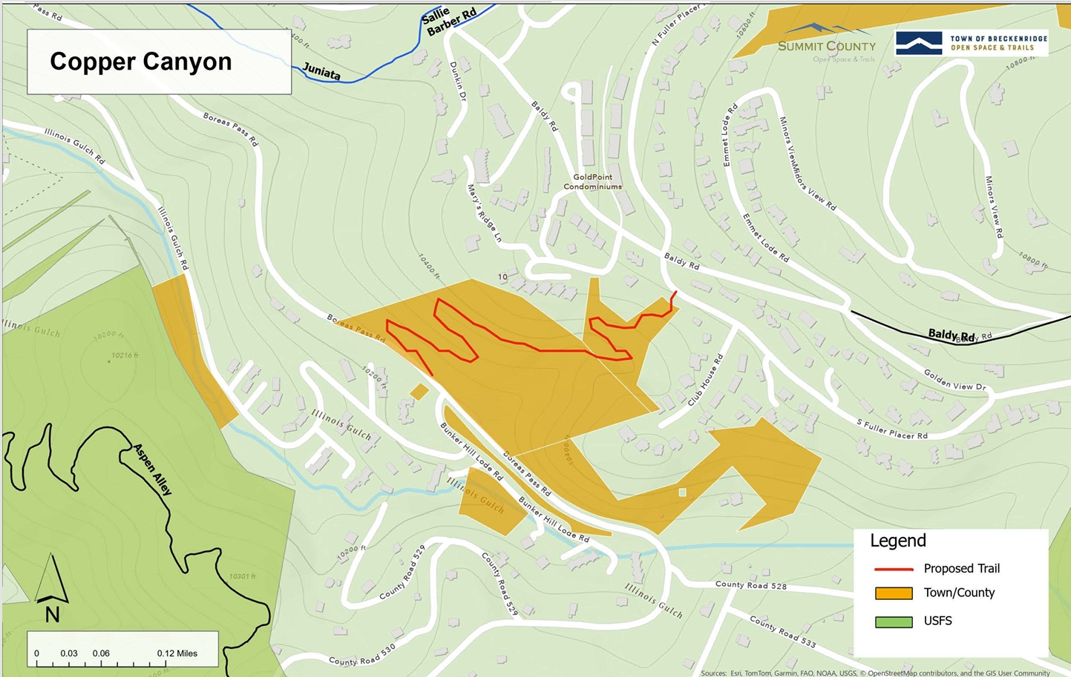
Exhibit A

